Slide 1

Software Development & Best Practices
Lecture 2 – Web Architecture Part I

Slide 2
Web Application Architectures

Slide 3
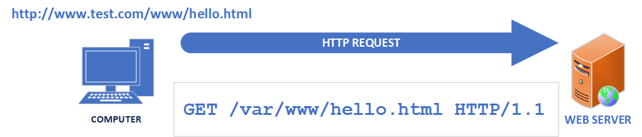
STATIC HTML (legacy)
The oldest kind of web application is a static HTML page. It effectively treats the web server like a file server
The user requests a file by typing a URL into a web browser. The first part of the address www.test.com tells the browser what computer to send the request to. The part after the first slash is where in the server's directory structure the file is located. This is also known as a “pathname”.
The browser requests the file by sending the word GET, the pathname and the version of HTTP protocol we are using (in this case 1.1) to the webserver in plain text.
The next slide shows exactly what is sent.

Slide 4
HTTP Request
GET /var/www/hello.html HTTP/1.1
User-Agent: Mozilla/4.0 (compatible; MSIE5.01; Windows NT)
Host: www.test.com
Accept-Language: en-us
Accept-Encoding: gzip, deflate
Connection: Keep-Alive
(there are two <CR><LF> sequences here)
Data entered by the USER
HTTP Request Method
Information supplied by the Browser

Slide 5
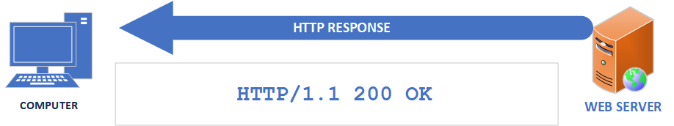
STATIC HTML (legacy)
404 Not Found
What the web server does next is look for the file in the specified directory
If the file is found (and the web server has access to it) a HTTP response is sent.
This starts by sending (in plain text) the HTTP version, then the response code and a short message explaining it.
Since the server found our file without any problems it sends the code “200” and the message “OK”. Then it adds to the end of the response the contents of the file.
If it isn’t found, the error code “404” is sent followed by the message “Not found”.
Your computer receives this response and sends it to your web browser.

Slide 6
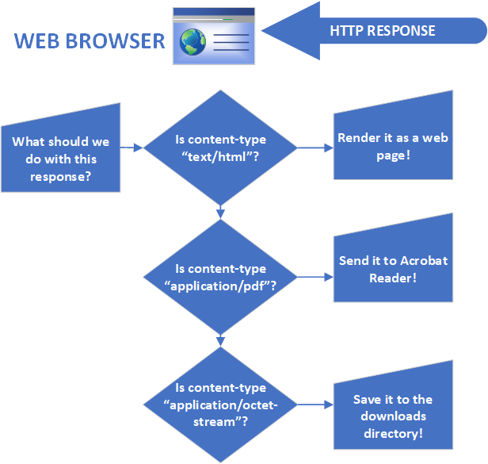
STATIC HTML (legacy)
To determine what to do with the data in the file the webserver sends a “hint” in the response as to what kind of file it is sending you. This is known as a “Content-Type”
If the “Content-Type” is “text/html” then the web browser starts interpreting it as HTML. If it is something else like “image/jpeg” then it treats the data like a .jpeg image file.
Sometimes the browser needs another application to interpret the data and tells the operating system to open it. “application/pdf” can be used to invoke your PDF reader.

Slide 7
STATIC HTML (legacy)
It’s also possible for the browser to just save the attached file in a directory. When you download a file from the internet. The webserver generally sets the Content-Type to “application/octet-stream” which is just a way of saying “A bunch of bytes”. Browsers will see this and simply save the file on your machine.
An example of what an HTTP Response looks like is on the next slide.

Slide 8
HTTP Response
HTTP/1.1 200 OK
Date: Tue, 27 Dec 2020 10:28:53 GMT
Server: Apache/2.2.14 (Win32)
Last-Modified: Mon, 15 Jul 2020 19:15:56 GMT
Content-Length: 88
Content-Type: text/html
Connection: Closed
<!DOCTYPE html>
<html>
<body>
<h1 style="color:green;">Important things!</h1>
<p style="color:purple;">Not-so-important things.</p>
</body>
</html>
The part highlighted in YELLOW is the HTTP HEADER
The part highlighted in GREEN is the HTML DATA

Slide 9
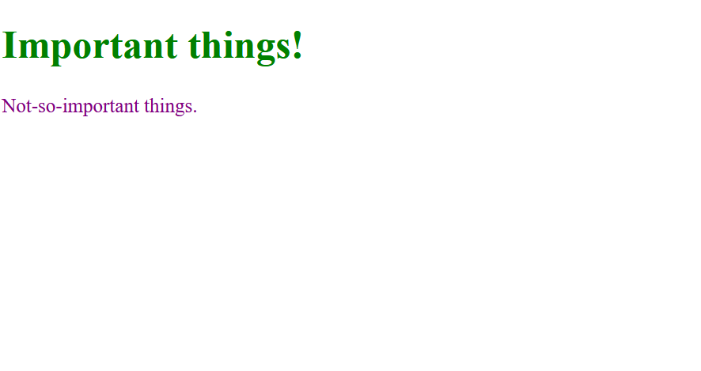
HTML Interpretation
BROWSER OUTPUT
HTML CODE
<!DOCTYPE html>
<html>
<body>
<h1 style="color:green;">
Important things!</h1>
<p style="color:purple;">
Not-so-important things.</p>
</body>
</html>

Slide 10
HTML FORMS
In the original definition for HTML (sometimes called HTML 1.0) documents could only be fetched. Web pages were primarily made up of text and links to other documents.
This all changed when the HTTP 1.0 spec introduced a new Request-method: “POST” which allowed data to be sent to the server by placing it in the body of the HTTP request. Similar to the way that the contents of the file you are fetching are in the body of the HTTP Response.
POST didn’t get used very much until the next specification (HTTP 1.1). When a new concept was added: HTML forms. Forms allowed programmers to create an HTML page with fields that allow users to enter data and send this data to the web server by clicking a “SUBMIT” button.

Slide 11
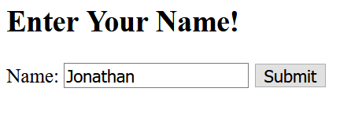
HTML FORMS
HTML form CODE
Resulting form
<!DOCTYPE html>
<html><body>
<h2>Enter Your Name!</h2>
<form action="http://172.16.1.242/webapp">
<label for="name">Name:</label>
<input type="text" id="name" name="name" value="Jonathan">
<input type="submit" value="Submit">
</form></body></html>

Slide 12
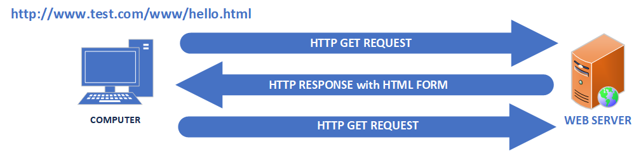
HTML FORMS
404 Not Found
By default, if the user fills out the HTML form and clicks the “submit” button. The browser makes another GET request but this time it only sends the form data to the web server.
However, if you recall the ONLY information passed from the user to the webserver in the GET method is in the URL.
So how does the browser send the form data back?

Slide 13
HTTP Request
GET http://172.16.1.242/webapp?name=Jonathan HTTP/1.1
User-Agent: Mozilla/4.0 (compatible; MSIE5.01; Windows NT)
Host: www.test.com
Accept-Language: en-us
Accept-Encoding: gzip, deflate
Connection: Keep-Alive
(there are two <CR><LF> sequences here)
Data entered by the USER
HTTP Request Method
Information supplied by the Browser

Slide 14

HTML FORMS
404 Not Found
Sending data in the URL line wasn’t considered a great idea. It was visible for anyone to see and there was a hard limit on the number of characters (around 2000 bytes). So, it wasn’t good for sending large amounts of data.
This was solved by using the POST method. As defined in HTTP 1.0, POST allowed data to be placed into the HTTP Request AFTER the headers. Similar to how a HTTP response returns HTML.
This is accomplished with the following changed to the HTML <form action="http://172.16.1.242/webapp" method="POST">

Slide 15
HTTP Request
POST /webapp HTTP/1.1
Host: 172.16.1.242
Content-Length: 130
Content-Type: multipart/form-data; boundary=----WebKitFormBoundary7MA4YWxkTrZu0gW
<CR><LF>
----WebKitFormBoundary7MA4YWxkTrZu0gW
Content-Disposition: form-data; name="name"
<CR><LF>
Jonathan
----WebKitFormBoundary7MA4YWxkTrZu0gW<CR><LF>
<CR><LF>
Data entered by the USER
HTTP Request Method
Information supplied by the Browser

Slide 16
HTTP Request Methods (Verbs)
Method/Verb | Result
GET | Retrieve information from the specified path on the webserver. The only information the user can send is in the URL. They can be cached, are part of your browser history, display sent data on the URL line (not good for sensitive data), have length restrictions. Generally used for retrieving data.
POST | Send information to the specified path on the webserver. Information can be sent in the HTTP Request header. They are never cached POST, do not remain in the browser history, no restrictions on data length. Generally used for creating data.
PUT | Send information to the specified path on the webserver. Often used for updating data.
DELETE | Send a delete request to the specified path on the webserver. Generally used for deleting data.
It’s important to understand that there is nothing FORCING a web application to behave in these ways!

Slide 17
HTTP Status Codes
Code | Message | Description
200 | OK | Standard response for a successful request
403 | FORBIDDEN | Server understood the request but is taking no action. This is often results from attempting to access a page that requires a username and password.
404 | NOT FOUND | The requested URL could not be found. Frequently the result of entering a URL which doesn’t point to an actual document.
405 | METHOD NOT ALLOWED | The server is telling you that the HTTP Request method you used is not allowed to access this resource. Frequently this is used by a web application that is trying to force the use of POST instead of GET for submitting form data.
These are just a few of the status codes. There are many more.

Slide 18

DYNAMIC HTML (SERVER SIDE)
Dynamic pages change the paradigm so that the HTTP Request is telling the web server to run a program instead of sending a file.
The program can be written in one of many programming languages (PHP, Python, Ruby, Java, C#).
The output of the program is an HTTP Response. This can include HTTP headers and HTML.
Because all this processing is done on the web server. This is often referred to as a “server-side script”

Slide 19
HTTP Request
GET /var/www/test.php HTTP/1.1
User-Agent: Mozilla/4.0 (compatible; MSIE5.01; Windows NT)
Host: www.test.com
Accept-Language: en-us
Accept-Encoding: gzip, deflate
Connection: Keep-Alive
HTTP REQUEST METHOD (VERB)
USER INPUT
BROWSER INFORMATION

Slide 20
DYNAMIC HTML (SERVER SIDE)
PHP CODE
RESULTING HTML
<?PHP
$message = "This HTML is generated by PHP!";
echo "<!DOCTYPE html><html><body><h2>PHP Demonstration</h2>
<div style='background-color:lightgrey;border:15px solid green;'>".$message."</div></body></html>";?>
<!DOCTYPE html> <html><body> <h2>PHP Demonstration</h2> <div style='background-color:lightgrey;border:15px solid green;’> This HTML is generated by PHP! </div> </body></html>

Slide 21
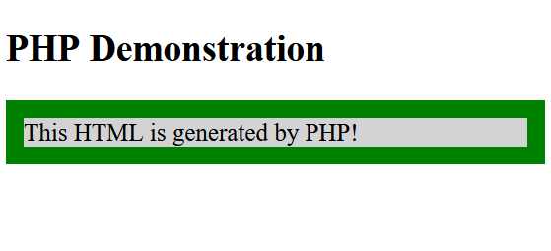
DYNAMIC HTML (SERVER SIDE)
HTML
RESULTING WEB PAGE
<!DOCTYPE html> <html><body> <h2>PHP Demonstration</h2> <div style='background-color:lightgrey;border:15px solid green;’> This HTML is generated by PHP! </div> </body></html>

Slide 22
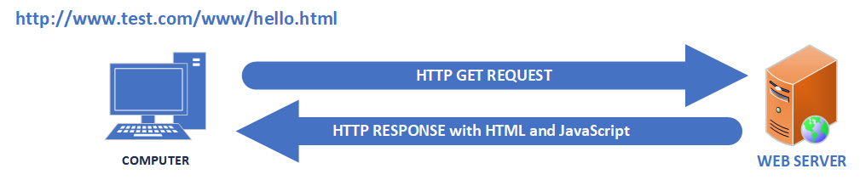
DYNAMIC HTML (CLIENT SIDE)
In 1995, as an effort to make HTML pages more interactive Netscape Inc. created a programming language that ran inside the browser which they called JavaScript.
The idea was that a browser could make a HTTP GET request to a web server and the response could contain HTML as well as a program written in this new language.
The program would run on the user's machine which would allow some things to be done more efficiently.

Slide 23
DYNAMIC HTML (CLIENT SIDE)
For example, if you had a HTML form that people could fill out. So, your company could email them some information. It would likely have a field called “EmailAddress”. Since you can’t email anything to someone who doesn’t provide their address. You might want to make sure that people entered something in that field.
The previous way to validate this input was to wait until the user submitted the form, have the server side script check it and then respond with an error message.
With JavaScript, you could check the contents of the field before it is sent to the web server.

Slide 24
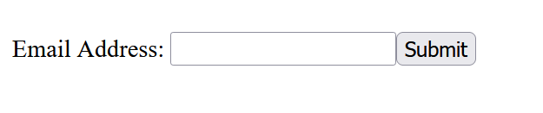
DYNAMIC HTML (CLIENT SIDE)
HTML + Javascript
RESULTING WEB PAGE
<!DOCTYPE html> <html><body><form name="Form1" action="/action_page.php" onsubmit="if (document.forms['Form1']['emailaddress'].value=='') { alert('I need an address');return false;}" > Email Address: <input type="text" name="emailaddress"> <input type="submit" value="Submit" > </form></body></html>

Slide 25
DYNAMIC HTML (CLIENT SIDE)
Closer look at the Javascript in the form TAG
<form name="Form1" action="/action_page.php" onsubmit=" if (document.forms['Form1']['name'].value == "" ) { alert('I need a name’); return false; } " >

Slide 26
WEB ARCHITECTURE OVERVIEW
There are several ways to interact with web pages. The simplest is to use HTTP to fetch a file from a web server. This file can contain just about anything: HTML, image or application data.
The web server replies with an HTTP Response message. and a status code. If the request is processed without an error. This code is usually “200”. If there are problems the code will be different. For example, if the file doesn’t exist, the web server could return a status code of “404”.
The HTTP Response message, the server sets a field called “response-type” to indicate the kind of data it’s sending you. Depending on the contents of this field the web browser might take different actions: render the HTML, draw an image, start your PDF reader.
If the browser sees a response-type of “text/html” it is going to assume that the HTTP Response contains HTML which will describe how the web page is supposed to look.

Slide 27
WEB ARCHITECTURE OVERVIEW
The HTML could contain a web form which allows a user to send data back to a web application.
The web forms can use either the GET or POST method to send data.
Using the GET method to send data exposes data on the URL line and has data length limitations. POST does not do this.
HTML sent from a web server could also contain JavaScript. JavaScript is a programing language which can alter the behavior of the web page. Such as changing an image or stopping a form from being submitted.
HTML sent from a web server does not have to be from a static file. It could be dynamically generated by a programming language such as PHP, Python, Ruby, Java or C#.

Slide 28
Examples

Slide 29
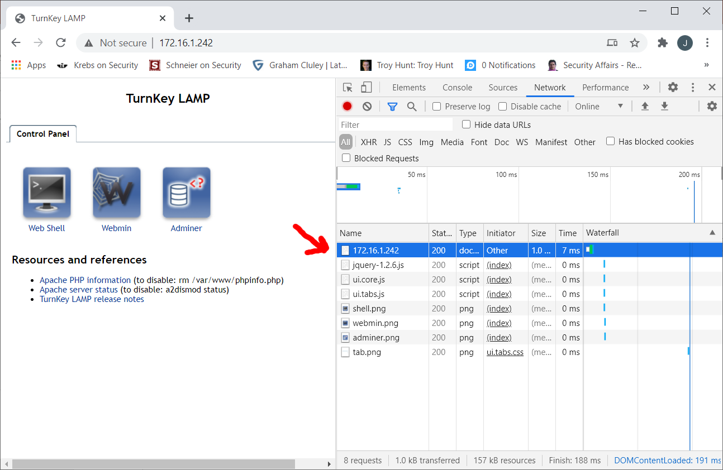
Making GET requests
The simplest way to make a GET request and observe the response it to simply use a web browser. Most modern web browsers have a way to get a detailed look as to what is going on.
On Chrome:
Type <Ctrl>+<Shift>+I to open up the “Developer tools” panel.
Type the address of a simple website in the URL bar. Such as your VM from Lab 0. The URL of mine was http://172.16.0.242
Look at the first entry on the list of HTTP requests. This is the initial HTTP Request made by your browser.

Slide 30
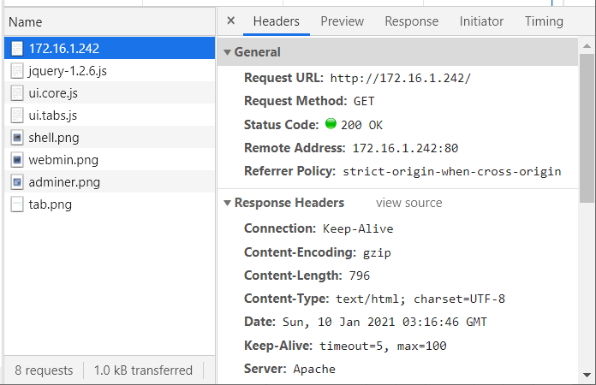
Making GET requests
Clicking on the initial request reveals the ALL the data from the HTTP Request.

Slide 31
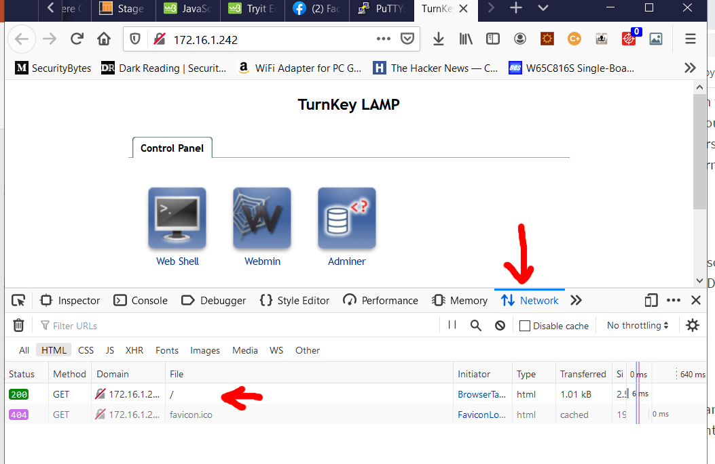
Making GET requests
On Firefox:
Type <Ctrl>+<Shift>+I to open up the “Developer tools” panel.
Click on the tab marked “Network”
Type the address of a simple website in the URL bar. Such as your VM from Lab 0. The URL of mine was http://172.16.0.242
Look at the first entry on the list of HTTP requests. This is the initial HTTP Request made by your browser.

Slide 32
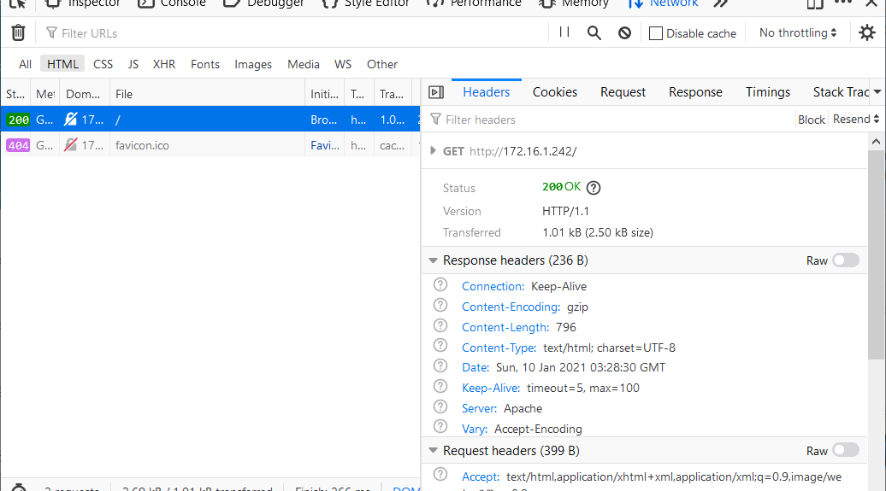
Making GET requests
Clicking on the initial request reveals the ALL the data from the HTTP Request.

Slide 33
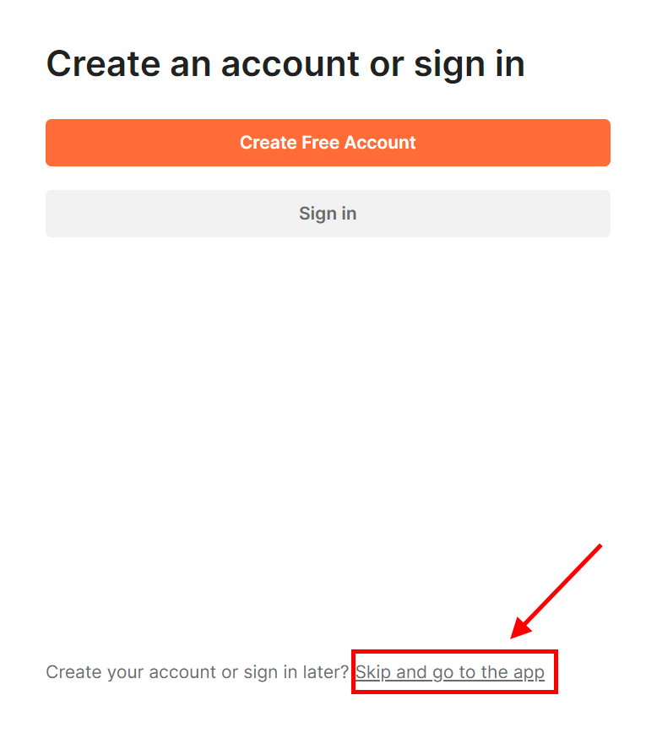
Making POST requests
If you recall a POST request, which sends its data inside the HTTP Response rather than as part of the URL is much more complicated to construct.
To create POST requests, we will be using a tool called POSTMAN. There are several ways to install this tool. One of the easiest is to use the PORTABLE version available in Canvas.
Just unzip the file into a directory and click on the postman-portable.exe file. If you have another version, you may need your professors help to install it.
Once it is up and running you should see a screen like the one on the right.
With the portable version there is no need to create an account. So just click “Skip and go to the app”.

Slide 34
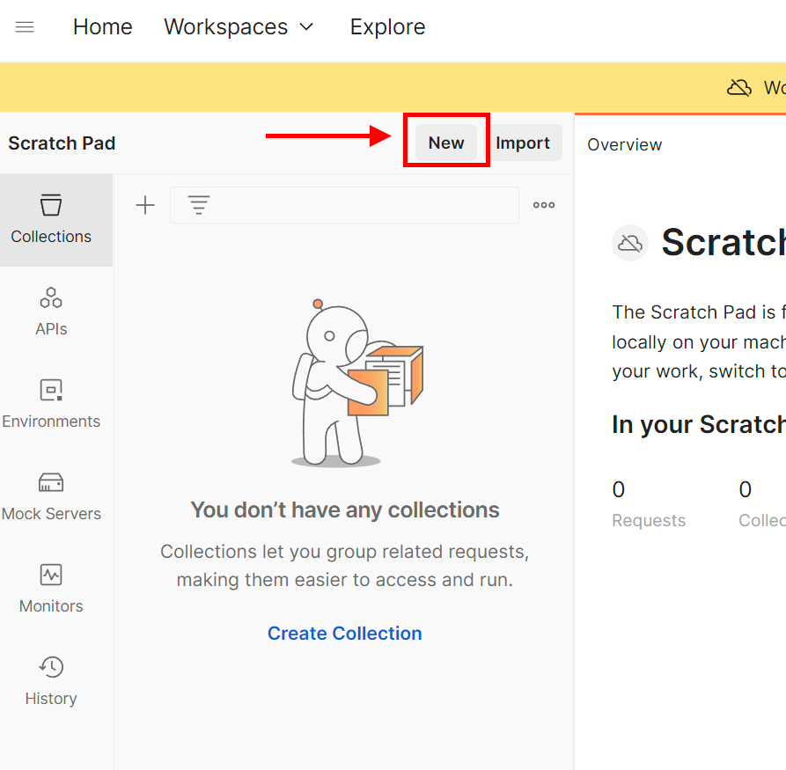
Making POST requests
In the top right corner, there should be a button marked “new”. Click on this.

Slide 35
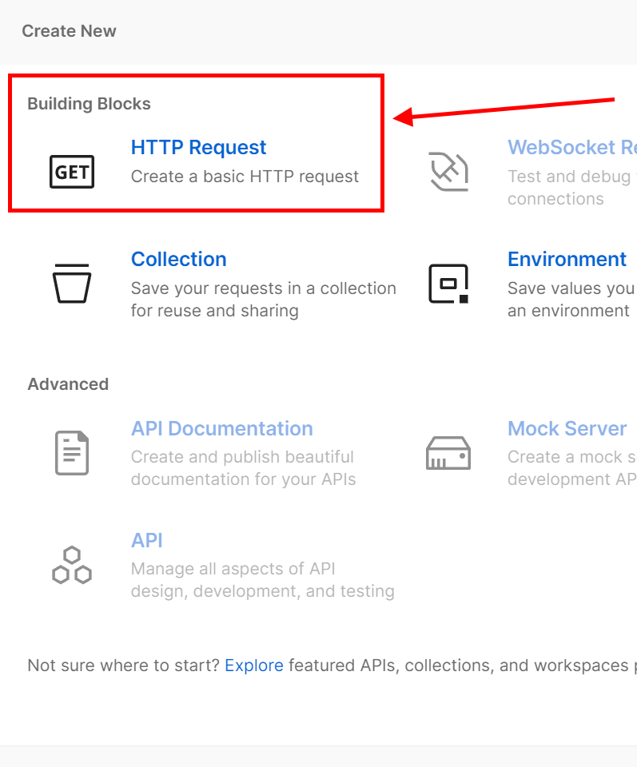
Making POST requests
The “create new” panel should appear. Select the “HTTP Request” option.

Slide 36
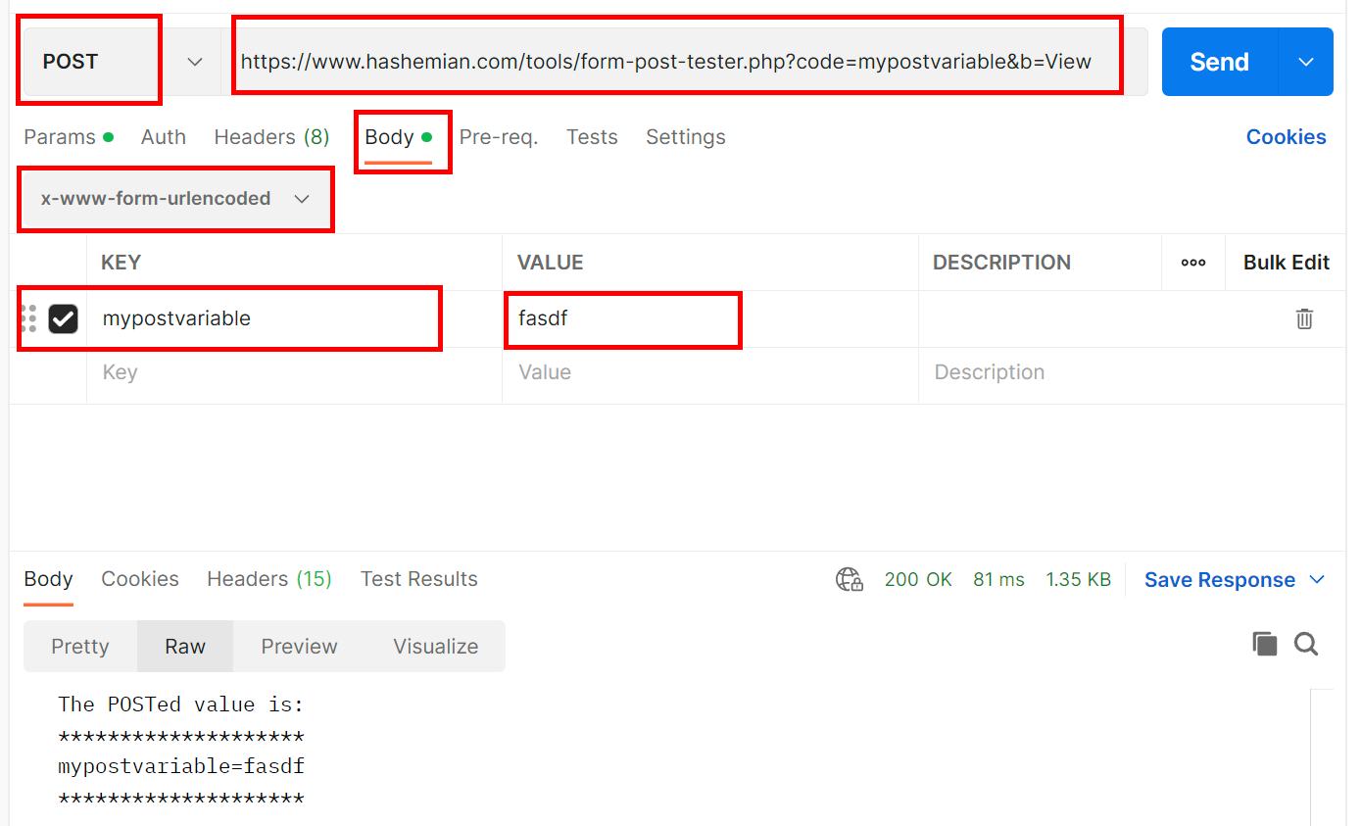
Making POST requests
From here we can create our POST request as follows:
First click on drop-down menu with the word “GET” on it. This tells POSTMAN what kind of request we want to send. Change it to POST
Enter the full URL of the site you are sending information to in the spot marked “Enter Request URL”.
For this example we will use a HTTP POST test site: https://www.hashemian.com/tools/form-post-tester.php?code=mypostvariable&b=View
Whatever we send this site in the form field “mypostvariable” it will send back to us.

Slide 37
Making POST requests
From here we can create our POST request as follows:
Click on the “Body” tab and make sure the “x-www-form-urlencoded” is selected.
Then enter the name of the field we are sending to our test site as “mypostvariable” in the value field you can enter anything you want.
Now you can click the blue “Send” button. If you have done everything correctly you should see output at the bottom of your screen which says “The POSTed value is” and the value you sent.

Slide 38
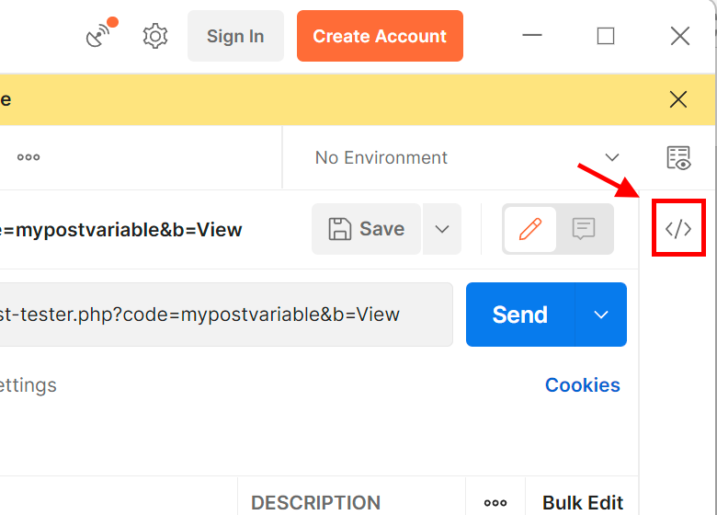
Making POST requests
If you would like to see exactly what the data, we sent the server looks like. Click on the </> icon on the right-hand side of the POSTMAN panel.
By default, POSTMAN shows you this data in cURL format. Click on the drop-down menu and select “HTTP”.
This should resemble the examples from earlier in this lesson.

Slide 39
SUMMARY
There are several ways to create and examine an HTTP Requests. The main two that we will be using for this course are:
POSTMAN
Chrome/Firefox developer tools
As we move forward in this course, we well be using these not just to examine what’s happening behind the scenes, but we will learn to use this information to forge or trick applications into working differently than their authors intended them to.

